Slide 1

Phone Pouches at St. Paul’s

Slide 2
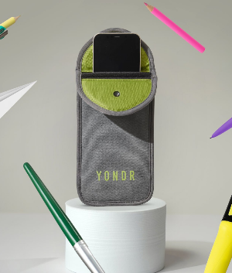
Our Phone-Free School
This year, our school will be using the Yondr Program to make our site phone-free.
We will be using a system called Yondr which has been implemented across 40+ countries to facilitate an engaged learning environment.
Every student will have a personal Yondr Pouch. It is each student’s responsibility to bring their pouch with them to school every day and keep it in good working condition.

Slide 3
Why Are We Going Phone-Free?
how many hours does the average adult spend on their phone each day?
  5 Hours
how many hours does a teenager spend on their phone each day?
  7+ hours
Our students deserve a learning environment where they can be free from the distractions of phones and social media.
Schools that use phone pouches report improvements in:
Academic performance
Classroom engagement
Social connection
Student wellbeing
Safeguarding incidents

Slide 4

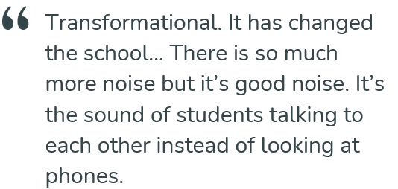
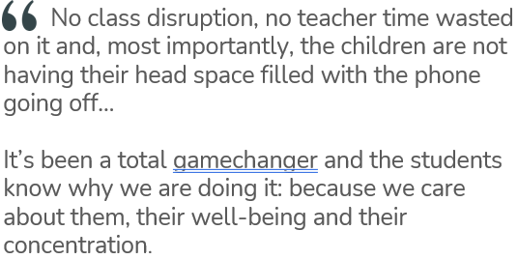
Schools that have implemented phone pouches say……

Slide 5


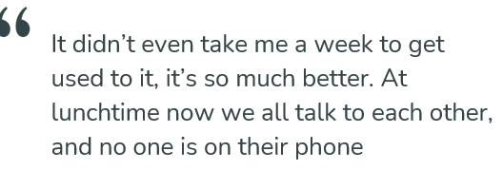
Students who have experienced phone pouches say……

Slide 6
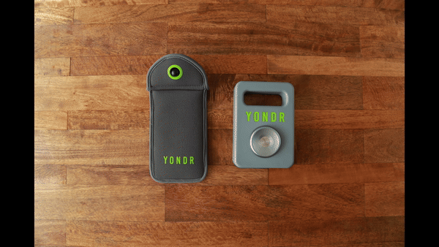
Arrival to School
Phones and smart watches are turned off.
Phones and smart watches are ‘pouched up’ under the supervision of a teacher.
Top of the pouch is closed.
Green button is pushed in to secure and lock.

Slide 7
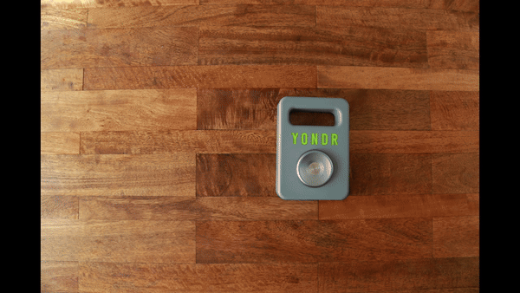
End of the Day
The pouch is tapped on the unlocking base on the side with the green circular ring.
As the pouch is tapped the button should be pushed to release the lock.
Phone is retrieved and the pouch is closed back up.
Phone is kept with the student ready for the next school day.

Slide 8
Frequently Asked Questions….
What happens if I need to reach my child during the school day?
  We want students to be engaged as much as possible in their learning. If you need to contact your child during the school day, please contact the main office who will take the appropriate action.
  The school is then able to control when this message is passed on to be the least disruptive for your child in class.

Slide 9
Frequently Asked Questions….
Will my child’s phone be safe?
  Students are in possession of their phone - in their phone pouch - for the entire school day. We will advise students to store the pouch safely in their bags.
What if the pouch is damaged, lost or stolen?
  If a student damages or loses their pouch, school staff will collect the phone/pouch and send it to the front office for the remainder of the school day. The replacement fee is £15.50.
  Examples of damage include:
  Bent pins
  Deep scratches on the plastic globe and the surrounding green ring
  Intentional pen marks on the inside
  Pin and button not fully recessing
  Cut/torn pouches

Slide 10
Frequently Asked Questions….
What happens if a student unlocks their pouch without permission, damages it, or uses an alternative phone?
  Students will be subject to confiscation and sanctions.
  Pouch checks are an important part of the school day. We want to ensure that students understand that checks can be done at any time.
  Students soon understand that it’s better to keep phone in pouch rather than risk confiscation or disciplinary action

Slide 11
Frequently Asked Questions….
What happens if a student forgets their pouch?
  If a student forgets their pouch, they must have their phones stored in the office for the school day. The phone will be returned to the student at the end of the day.
  If a student consistently forgets their pouch, it will be considered lost. Parents/guardians will be notified, and a replacement pouch will need to be paid for.

Slide 12
Frequently Asked Questions….
What happens if a student forgets to open their pouch at the end of the day?
  All students funnel past the unlocking stations at the exits, They want their phones back and don’t forget to unlock their pouches. If they do arrive home with a phone in a pouch, they can either come back to school to unlock it or have a phone free evening! Unlocking stations are accessible outside school even when school is closed!

Slide 13
Frequently Asked Questions….
What about Sixth Form?
They are role models and so must not use their phone in the vicinity of any younger children. The only place they may be used is in the top of J Block (the new build when it opens). Regular infringements will result in a pouch being issued for a fixed period of time.
What about the library and after school clubs?
The school site is phone free and so pouches must remain closed in the library and when on school site. They may be opened as pupils exit from reception when they leave school.

Slide 14
Frequently Asked Questions….
What happens if there is an emergency at the school?
  Mobile phones have been shown to cause distraction during emergencies. Students become concerned with texting parents and other peers to find out what is going on rather than listening to the adults who are guiding them through emergency procedures.
  If there is a schoolwide emergency staff have access to portable unlocking stations and will support the students in unlocking pouches when it is safe to do so.

Slide 15
Purchasing Phone Pouches
Years 7 to 10 will receive a free phone pouch.
From the 1st September, new Year 7 students will need to purchase their phone pouch as it is on our compulsory equipment list.
Replacement Phone Pouches can be purchased via WisePay at a cost of £15.50

