Slide 1

Year 13
Parent Information Evening
29th February 2024

Slide 2
Focus for this evening:
Welcome and introduction
Student Finance – Mr David Seaton, Assistant Director: Student Recruitment & Admissions at the University of Bedfordshire
The apprenticeship route
My UCAS application is submitted…what next?
The final countdown
The presentation will be available via the school website from tomorrow morning

Slide 3
Student Finance
Thank-you to Mr David Seaton
Assistant Director: Student Recruitment & Admissions at the University of Bedfordshire

Slide 4
Student Finance Explained
You can start to sign up for alerts:
https://www.gov.uk/student-finance
https://studentfinance.campaign.gov.uk/

Slide 5
Student Finance Explained
Watch this presentation
This video has kindly been provided by Lilly Bygate, Student Engagement & Recruitment Officer from the University of Bedfordshire.

Slide 6
Apprenticeships

Slide 7
What level?
There are four levels of apprenticeship available, each offering different levels of qualification. Students should be looking at:
Higher Level apprenticeships (Level 4 and above)
Degree Level apprenticeships (Levels 5 – 7)
Higher Level apprenticeships (Level 4 and above)
Equivalent to a foundation degree, Higher National Diploma, NVQ Level 4.
Typically need Level 3 qualifications such as A-levels, NVQs or a BTEC, ideally relevant to apprenticeship standard.
Could take up to five years to complete, depending on pace of study.
Degree Level apprenticeships (Levels 5 – 7)
Equivalent to a bachelor’s or master’s degree.
Typically need A-levels, or significant work experience in a similar sector.
Could take up to six years to complete.
Time is split between job and university, usually 80% at work and 20% study.
Will be up against employed adults and, maybe, existing staff.
Notes:
Students should be looking for higher or degree level apprenticeships.
NAW and National Apprenticeships Show 15th and 16th March

Slide 8
Is an apprenticeship right for you?
What is your end goal?
What do you want to achieve?
What is your learning style?
What are your aptitudes, where do your skills and talents lie?
E.g. Engineering:
I like independent study, I like looking at why things work, I do not mind exams. Then university might be the better option.
I like to work with others, I like to be hands on when understanding why things work, I don’t really like exams, I want to be out in the real world. Then an apprenticeship might be the better option.
https://www.ucas.com/understanding-apprenticeships

Slide 9
Where do I find the apprenticeships?
There is no central processing site for apprenticeships. The websites below show what is on offer at the moment. These are updated daily, so it would be a good idea to set alerts.
https://www.gov.uk/apply-apprenticeship
https://www.apprenticeships.gov.uk/
https://careerfinder.ucas.com/jobs/apprenticeship/
https://www.getmyfirstjob.co.uk/Choices/Apprenticeships.aspx
https://www.cityandguilds.com/apprenticeships
https://www.stepintothenhs.nhs.uk/apprenticeships
https://careerfinder.ucas.com/jobs/apprenticeship/
https://amazingapprenticeships.com/
https://www.getmyfirstjob.co.uk/discover/search.aspx?page2636=1&size2636=24
https://www.prospects.ac.uk/jobs-and-work-experience/apprenticeships/degree-apprenticeships

Slide 10

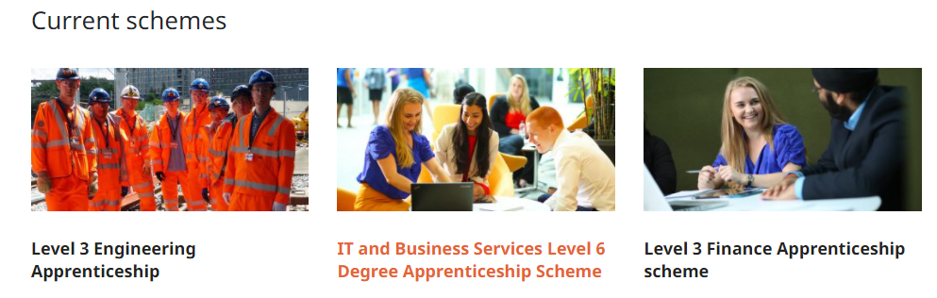

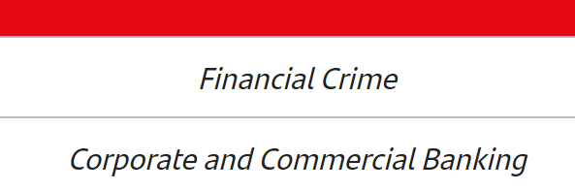

Looking beyond the name of local employers?
Network Rail is a large employer in Milton Keynes. They obviously offer Engineering apprenticeships but a business this size is also able to offer Business, IT and Finance apprenticeships. And you do not have to love railways for these roles.
Cyber Security

Slide 11
Applying for apprenticeships?
For each apprenticeship students will need to complete an application, similar to that for a normal job. Help is available in school and via the resources on itslearning.
Students will likely be asked to complete a number of things by the company including attending an interview and completing tasks within a specific timeframe.
In school we can provide students with a quiet place and time out of lessons to complete these, so students should let us know in advance.

Slide 12


The aim of these slides is to provide additional information relevant to a student’s current application status
Where Mrs Albone’s avatar appears there are voice clips with additional
information about the key information contained within the slides.

Slide 13
Key Dates for UCAS
24th February UCAS Extra opens for eligible students (those who have no offers)
16th May 2024 Decision made by all universities for students who submitted by the Jan deadline.
6th June 2024 Deadline for decisions on Conditional Firm and Conditional Insurance offers
4th July 2024 UCAS Extra closes
5th July 2024 Clearing opens
15th August 2024 Results Day
Notes:
UCAS Extra - a 'bonus round' for students to apply to another university course if they haven't had an offer from their original five choices.
Clearing - matches applicants to university places that are yet to be filled. It's available to anyone who has made a UCAS Undergraduate application and doesn't hold any offers. First come first serve basis.

Slide 14
You have time on your side
The deadline for universities to respond to applicants is 16th May 2024
You have until 6th June 2024 to decide which you will choose as your firm/ first choice course and which will be your insurance (2nd choice) course.

Slide 15

Waiting for feedback
Do not make any final decisions until you have all the feedback from all five courses so that you make an informed decision.
Use the next few months to investigate your chosen universities further and find out more about the courses that are making you offers.
Universities have seriously ‘upped their game’ over the provision of “virtual” Open Days and Offer Holder Days. There are ever increasing opportunities for “Peer to Peer” chat.

Slide 16

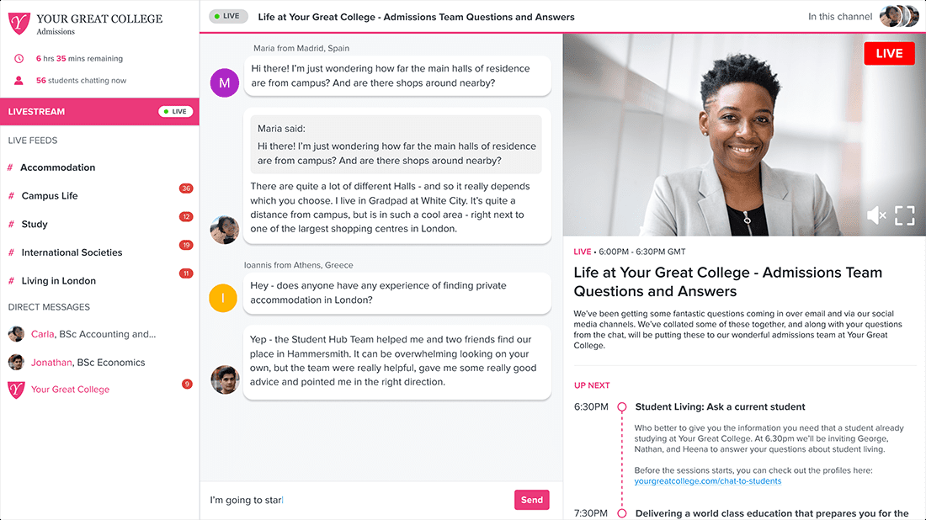
The following slides contain useful sites to investigate your university choices further:

Slide 17

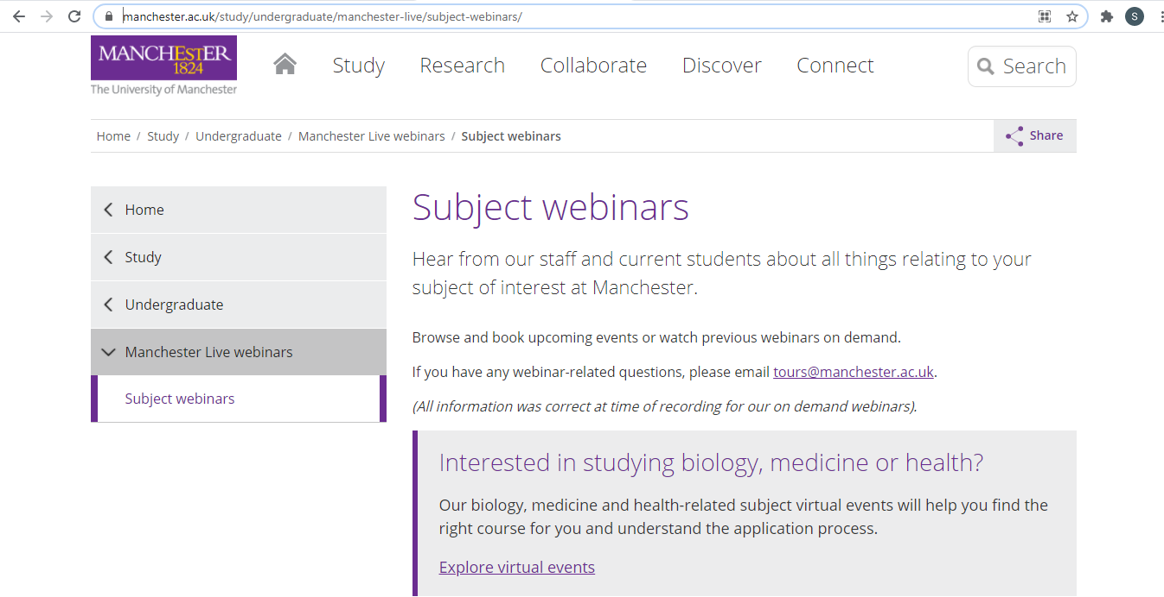
Subject Webinars
https://www.manchester.ac.uk/study/undergraduate/webinars/subjects/

Slide 18
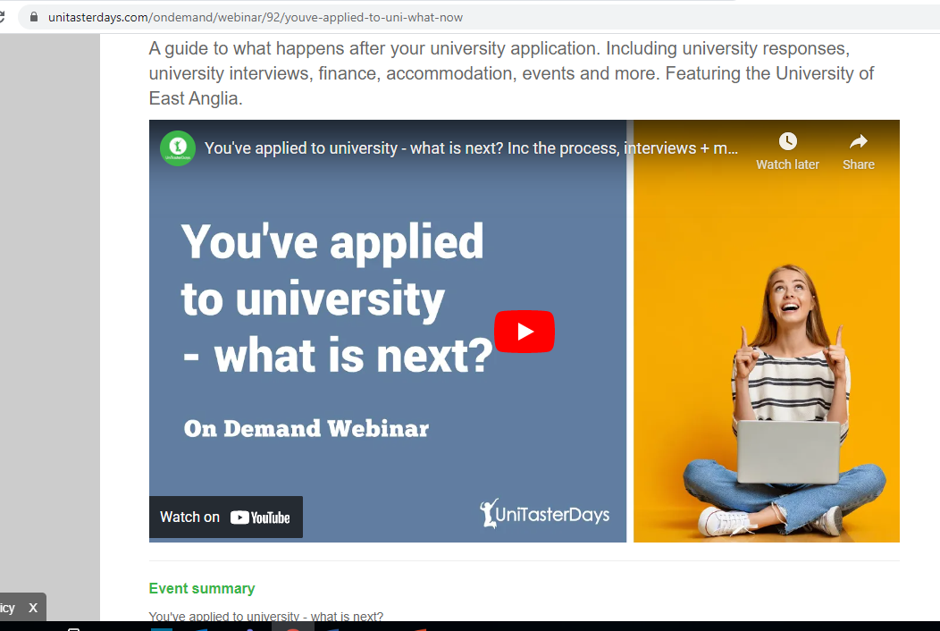
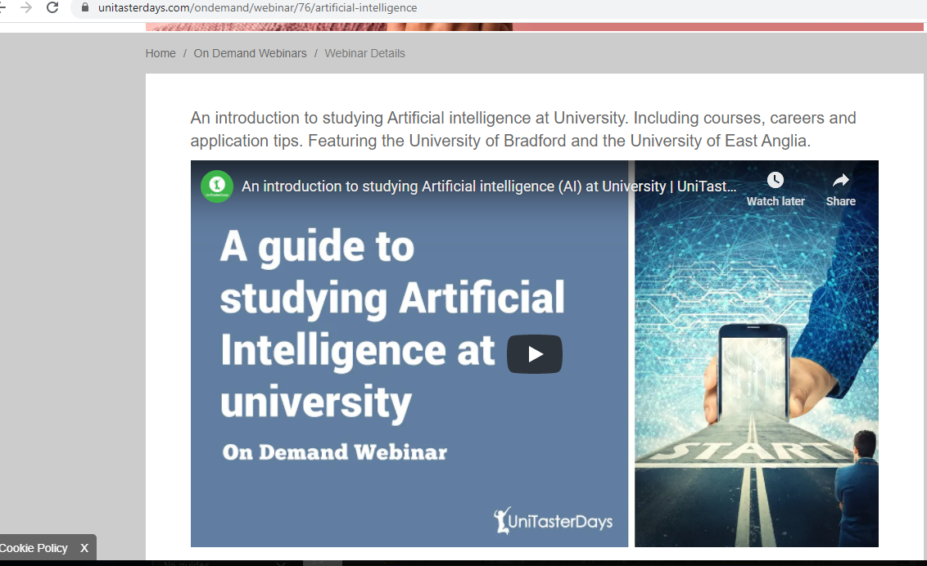
Unitasterdays.com

Slide 19
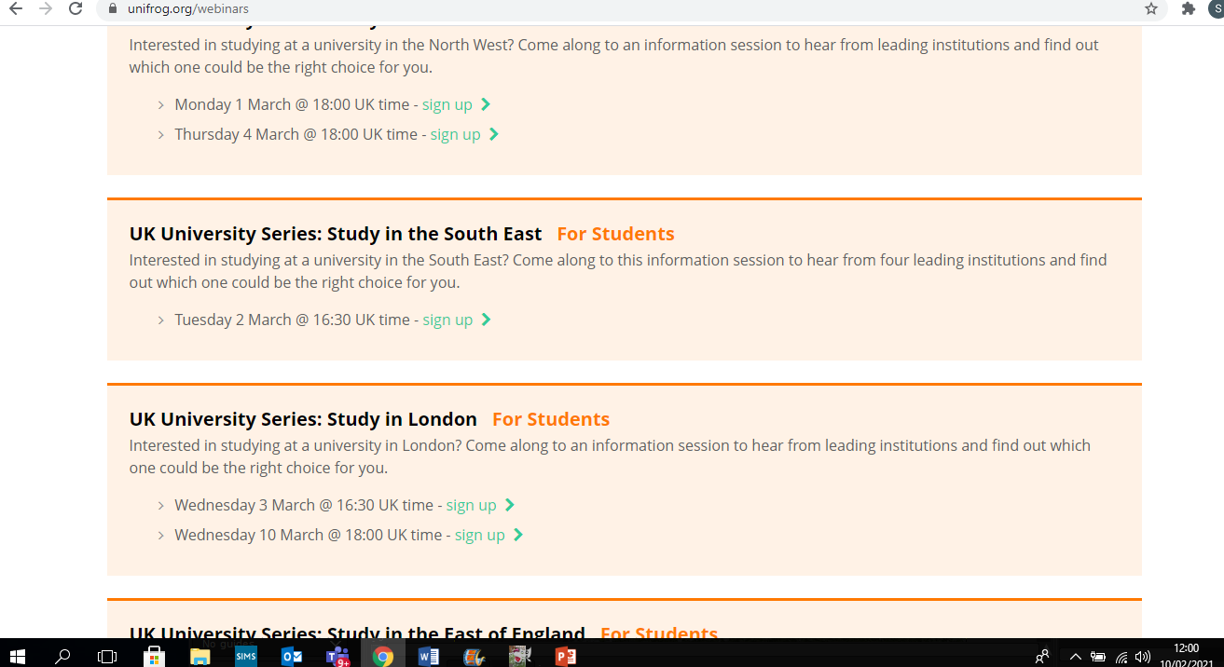
Unifrog - Opportunity for peer to peer interaction

Slide 20
Unconditional offers
Well done: be pleased with the strong impression that you have made.
But be wary of them- they are not always the best offers.
These must be looked at carefully and checked with your mentor, Mrs Peach, Mrs Enright or Mrs Albone

Slide 21
Conditional offers
You need to work out which of the conditional offers will suit you best and offer you the course that you will enjoy the most: this will become your firm choice.
Insurance choice: is there to protect you against the possibility that you do not get the grades to get into your first choice. The offer must be lower than your firm choice offer.

Slide 22
An ideal response to UCAS
Consider:
I like this course
I know the modules and topics covered I will enjoy
I have attended a number of in personal and/or virtual events and chatted to current undergraduates there.
What grades are they asking for e.g. BCC.
Your insurance choice will be the course you picked that is asking for LOWER grades e.g. CCD.
Notes:
Once the results are made public in August, you will be committed to taking up the firm choice if you are ‘firmly accepted’, or the insurance if you do not achieve the grades needed for the firm so…
…make sure that you are happy with both choices.

Slide 23
Sometimes it’s more complicated than that...
Sometimes students have very good reasons for choosing their firm choice because it is their favourite course even though it is the course that has offered the lowest grades.
If that is your situation, do not worry, have a chat with your mentor, Miss Nodwell, Mrs Enright or Mrs Albone

Slide 24
What if I do not get any offers?
Do not worry - this is just round number one.
If you hear back from all universities and you do not get any offers, you get through to round two: UCAS Extra.
UCAS Extra becomes available on 24 February 2024 and we are ready to help you.

Slide 25
What if I do not get the grades for my Firm or Insurance offer?
Do not worry - it is highly likely there will still be a university place available to you.
On results day UCAS will automatically enter you into clearing – which is now a sophisticated IT process which will make suggestions to you and put you in contact with admissions teams.
A number of staff will be available to support you through this process if needed.

Slide 26
And finally…
We have 8 academic weeks remaining. Students should be in school every day, in all their timetabled sessions, and planning and making most of their study periods.
PPE results: students have now received these – how will this impact of future destination choices?
Mentoring evenings are taking place on the 21st (virtual) and 25th face-to-face) March. Appointments will be bookable soon
Wednesday 13th and Thursday 14th March National Apprenticeship Show at the MK Dons stadium. This will be an excellent opportunity to speak to employers if students are considering an apprenticeship. Year 13 are encouraged to attend on the Wednesday afternoon if they do not have lessons, or after school

Slide 27
If you have any further questions, please contact a member of the pastoral team…
Lisa Shepherd – Year 13 Year leader
Lisa.shepherd@st-pauls.org.uk
Sharon Robinson – Sixth Form Pastoral and Chaplaincy Leader
Sharon.robinson@st-pauls.org.uk
Grace Enright – Sixth Form Study Supervisor
Grace.Enright@st-pauls.org.uk
Sharon Albone – UCAS Coordinator
Sharon.Albone@st-pauls.org.uk
Lois Peach – Administrator for Year 13
Lois.Peach@st-pauls.org.uk
Fiona Nodwell – Head of 6th Form
Fiona.nodwell@st-pauls.org.uk

