Slide 1

Year 9: Work Experience and Metacognition
30/6/26
Head of Year
Mrs Bolton
Kaylee.Bolton@st-pauls.org.uk
Pastoral Leader
Kay Klymyszyn
Kay.Klymyszyn@st-pauls.org.uk
Deputy Headteacher
Mrs Eastwood
Catherine.Eastwood@st-pauls.org.uk

Slide 2
Year 9
Work Related Learning Day: Wednesday 8th July
Trips Day: Thursday 9th July
Sports Day: Friday 10th July
End of term and rewards assembly: Friday 17th July, 2:30pm
Official end of KS3
Over the Summer, please ensure students have correct uniform, equipment etc., so they come back in September prepared for KS4.
Back to school: Thursday 3rd September 2026

Slide 3
Work Experience
18th January 2027– 29th January 2027
What parents have received
Launch letter
Work Experience support booklet
Placement tool video (how to enter a placement)
Unifrog parent accounts activated with instructions
Students have received
Launch Assembly
Support sessions – to find a placement and how to enter it onto Unifrog
Class chart updates

Slide 4
What's to come…
Summer booklet to be sent home at the end of term. To help and support your child in securing a placement
Reminder letters to be sent home throughout the summer holidays
Support sessions throughout September/October/November and December
Extra support will be provided for EHCP/ Emmaus and EAL
Where possible careers will advertise placements on Class Charts, this will be a first come first serve basis
The first 40 students that have secured and entered their placements onto Unifrog will receive at free breakfast in October. Spaces are still available…
Would parents value a support session in finding a placement? Please email workexperience@st-pauls.org.uk to show your interest.

Slide 5

Process and Guidance – How to find a placement?
1.Think of what you would like to do? What subjects do you enjoy/ or are good at? What hobbies do you have? Think of your skills/abilities and interests
2. Research Companies
3.Contact by Email/ Telephone – Templates are at the back of the combined work experience booklet
4. Once Work Experience is agreed you need the contact details to fill in on Unifrog
Name of Business
Contacts Name you are speaking with
Contacts Email
Contacts/ Company Telephone number
Contacts/ Company address
Please ensure you arrange an interview with your employer once you have secured a placement.

Slide 6
Students have been informed and reminded multiple times to start looking for their 2 weeks worth of work experience placement.
The deadline for work experience is Monday 7th December 2026, as this allows the careers team to complete all relevant checks.
Parents that require further assistance please email on workexperience@st-pauls.org.uk or careers@st-pauls.org.uk
Students are advised to message on class charts/ visit the careers office (J205) or speak to a teacher if they need assistance.

Slide 7

Metacognition
What is it?
Why is this useful for my child?
What strategies can I use to support my child at home?

Slide 8

Metacognition: What is it?
Metacognition is commonly defined as "thinking about your own thinking".
It is the ability to step back, observe how you process information, and consciously control your own learning, decision-making, and focus.

Slide 9
Metacognition: Why is this useful for students?
1. It transforms students from passive receivers of information into autonomous learners
2. They understand their learning in a much deeper way.
3. Build resilience; When students struggle with difficult material, metacognition prevents them from giving up
4. Lifelong skills; It gives students the ability to "learn how to learn."

Slide 10
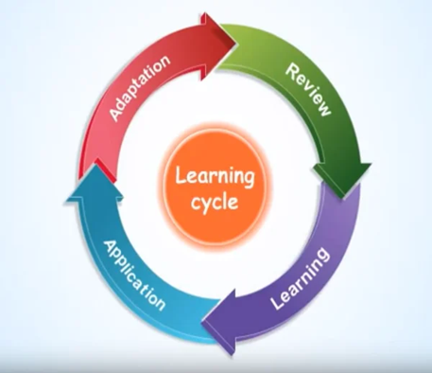

We want our students to think…
In order to get ideas, make decisions, weigh something up, do something… we require our brains to think.
If you consider just verbs, the Oxford English Dictionary rates the word think as the twelfth most used verb in the English language!

Slide 11





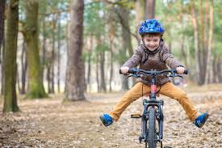
Teenagers start thinking well before they start any classroom…
DECISION MAKING
What do we do when we are asked to think?
CREATIVITY/NEW IDEAS
MEMORY

Slide 12
Ways to support teens to think hard. Questions should be…
• Open-ended. Give your child some space to reflect on their thinking: Can you tell me more about why you think that?
• Solution-focused. Encourage them to think about how they can use their understanding to change things in the future: How could you handle that differently next time?
• Process-oriented. Ask questions that help your child get a better idea of how their thought process works: How will you know when this drawing is finished?

Slide 13
Here are nine simple questions that can help develop metacognitive strategies in each of the three stages of learning.
Before a Task - Is this similar to a previous task? What do I want to achieve? What should I do first?
During a Task - Am I on the right track? What can I do differently? Who can I ask for help?
After a Task - What worked well? What could I have done better? Can I apply this to other situations?

Slide 14
Metacognitive strategies
Predicting outcomes- It helps the learner realise which information is needed to solve a problem and compare the initial understanding to the final result.
Evaluating work- Identifying strengths and weaknesses in the child’s thinking process as well as in their work is key.
Questioning- Ask questions such as “what are you doing now? “why are you doing it?” and “how does it help you?”
Self-assessing – Children must reflect on their performance to determine: what they’ve learned, how well they’ve learned it and the skills they needed to develop to solve the task.
Self-questioning- Children question their own knowledge while learning and working, in order to direct their thinking and determine the help they may need.

Slide 15
Metacognitive strategies
• Using discourse – Discussing ideas with parents and teachers’ helps them ask questions, recognise gaps in their own knowledge, as well as learn from others.
• Critiquing - Giving and receiving constructive feedback helps learners to verbalise their thinking and to improve their performance and thinking process.
• Revising - After receiving feedback children update their thinking and this helps knowledge stick in their long- term memory. Regular homework=5months extra progress in a year!

Slide 16
More support on Metacognition
Focus area | Link
Five ways to motivate your teen to study at home | https://www.bbc.co.uk/bitesize/articles/zbfrsk7
Can’t sleep, won’t sleep? Five ways to get your child’s sleep back on track | https://www.bbc.co.uk/bitesize/articles/z3kbsk7
Revision: how to get organised | https://www.bbc.co.uk/bitesize/articles/z83cqhv
Revision: timetables and planning | https://www.bbc.co.uk/bitesize/articles/zn3497h
Revision: how to stay motivated | https://www.bbc.co.uk/bitesize/articles/zq2hb82
Revision: memory hacks and tips | https://www.bbc.co.uk/bitesize/articles/z6pv3k7
Revision: how to use past exam papers | https://www.bbc.co.uk/bitesize/articles/zx6nrwx
Revision: top revision tips | https://www.bbc.co.uk/bitesize/articles/zw8qpbk
Revision: how to keep calm | https://www.bbc.co.uk/bitesize/articles/zxtf4qt
Making Notes | https://oxfordlearning.com/5-effective-note-taking-methods/

