Slide 1

Year 8 Options Information Evening
February 2026

Slide 2
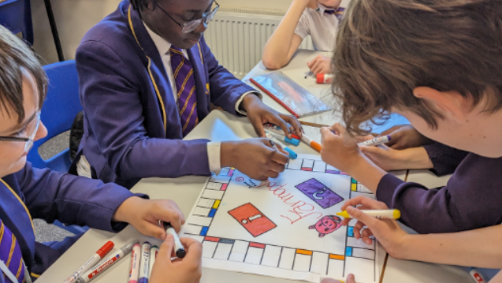
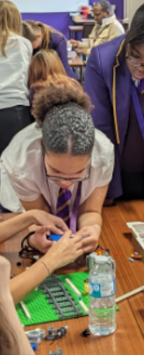


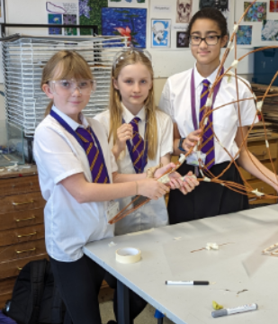
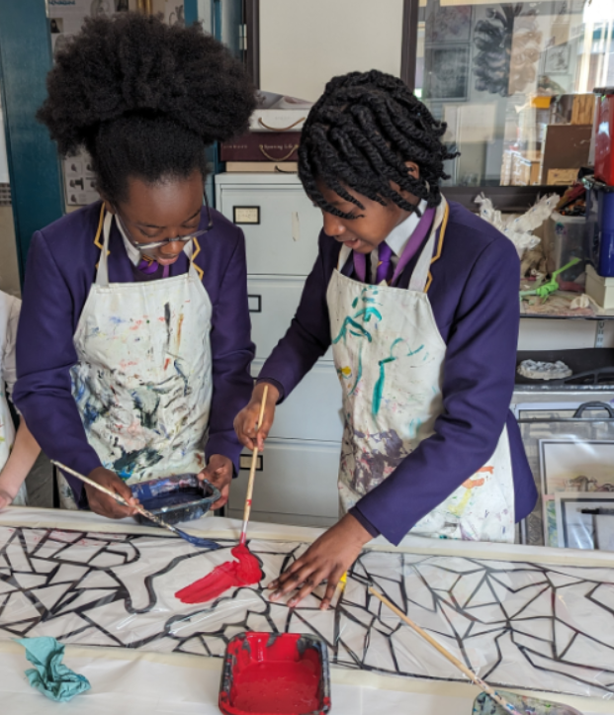
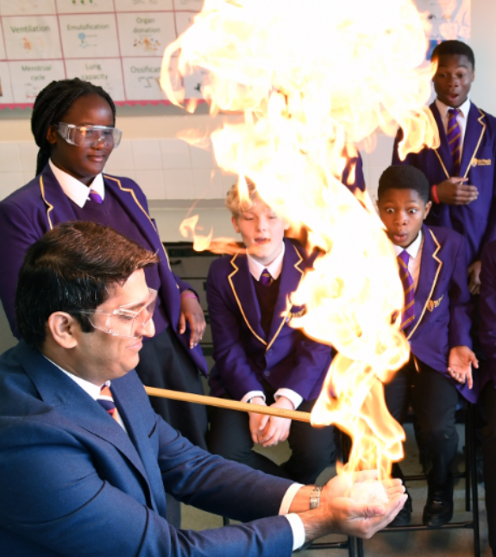
Year 8 Options Information Evening
February 2026

Slide 3


Mission Statement
Ministerium Tuum Imple (2 Tim 4:5)
St. Paul wrote these words to the disciple Timothy when he was in prison at the end of his life. He passed on his mission, as a follower of Jesus Christ, to Timothy and to us. We are called to be a community where Christ is present and is taken to others. We receive the gift of God’s love and grace and share in His mission of following Christ’s example by:
Being a community in which our LOVE of God and LOVE of each other can be seen in everything we do;
Using our gifts and talents to SERVE others, particularly those who are more vulnerable;
Being determined to DO THE BEST THAT IS POSSIBLE in everything we do to enable us to fulfil our ministry.
Notes:
The Foundation
This is a Catholic School in which we strive to achieve academic excellence and where we love, serve and do the best that is possible.
Mission statement is the foundation of everything that we do. We have to make it fully alive in our community and part of the very fabric of the place and defines our school culture.

Slide 4
Key Priorities For Our School
We will ensure that students:
Take responsibility for their own learning through thinking hard.
Take responsibility for their own behaviour by making good decisions.

Slide 5

Notes:
Briefly explain two sides to whole school curriculum CST / Academic Excellence embedded through Learning Talents

Slide 6


Slide 7
Academic Excellence means:
the provision of a broad and balanced curriculum and enrichment experience.
the commitment to the development of academic learning talents.
the development of subject scholarship.
the ability of students to articulate learning.
Notes:
Mention extra curricular dofe
PSHE
WEX / Careers
World challenge

Slide 8
The Key Principles of the Options Process
Students in Year 9 will continue to study a broad and balanced curriculum: RE, English, Maths, Sciences, MFL, Technology, History, Geography and Core PE
Most students will eventually study 10 GCSEs
Students will continue to study BOTH History and Geography until the end of Year 9
Most students will continue to study a Modern Foreign Language until the end of Year 11

Slide 9
So why is Year 8 important?
In Year 8 students will have their first opportunity to make choices about their future studies.
They will take the big step of choosing a preferred subject to study through to GCSE and a further Expressive Arts Option they will study for one year only (the end of Year 9). They will also select their preferred Technology route too.
This process will start to mould their choices and future direction. It is a guided choice with teachers and parents all guiding and supporting children to make the most appropriate choices.

Slide 10
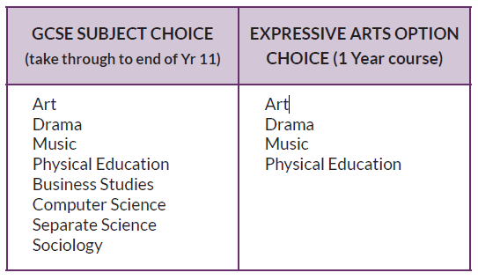
Students will get to choose one from each:

Slide 11
In addition to this, children will also choose a Technology Specialism from:
OCR GCSE Design and Technology
QA Food Preparation and Nutrition
OCR Cambridge National in Engineering Manufacturing
This choice will be handled and administered by the Design and Technology Department within their lessons. However, they are here tonight to help explain to you the different strands that exist, as well as student suitability for each.

Slide 12
Modelling How to Make Good Choices
The process of choosing their preferred GCSE, Expressive Arts and Technology route is as important as the subject choice itself.
It is the first time they will have done this: therefore, help is at hand.
Please visit all the subject stands tonight. Ask questions and think about aptitudes, interests and skills.
Speak with parents, teachers and our careers team who are also present this evening.
Do not make biased decisions based on favourite teachers or what your friends pick.
Notes:
Emphasise how at post 16 they will be making more significant choices and thinking through this process thoroughly in year 8 should help them later on in life too.

Slide 13
NEXT STEPS…..
Visit the subject stalls, gather information and discuss potential ideas.
Appointments will then take place with members of the Leadership Group and Year 8 Pastoral team. Please book a slot to suite you at the available times between the 23rd February and 13th March. You can book these slots via SchoolCloud. Your son or daughter will also be present at this meeting too.
SchoolCloud will be open for booking appointments from 9am tomorrow until 12pm on the 6th March.
At the meeting you will be asked to make your preferred choices for the GCSE subject and the Expressive Arts Choice.
Technology choices will be made during lessons.

Slide 14
Await the outcome….
Once we have all the preferences, we can start to build the timetable for next academic year and check if we have capacity to offer all students their first preferences.
Last year we were successful in doing so.
However, this is not always the case as some courses can become oversubscribed.
Therefore, we ask you rank subjects 1st, 2nd, 3rd. It is possible that not everyone will get their first choice.
You should hope to find out the outcome of your choices by May half term.

